Slide 1
Phase 2 Orientation
Intel Edge AI Scholarship
April 17, 2020

Slide 2
CONGRATULATIONS! 🎉
You did it!
You’re moving on to Phase 2!

Slide 3
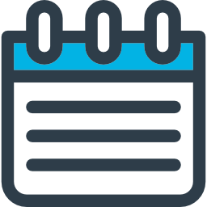
Nanodegree Overview
Project Review Process
Plagiarism and Academic Honesty Policy
Phase 2 Resources
Program Advice
FAQs
Open Q&A
TODAY’S
AGENDA

Slide 4
Nanodegree
Overview

Slide 5
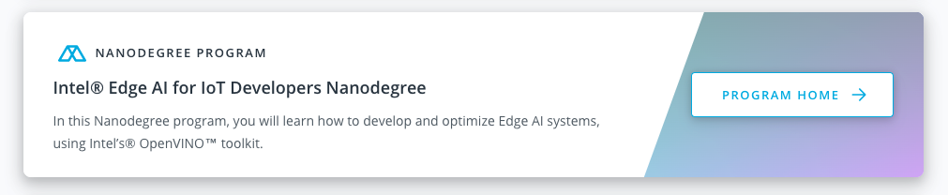
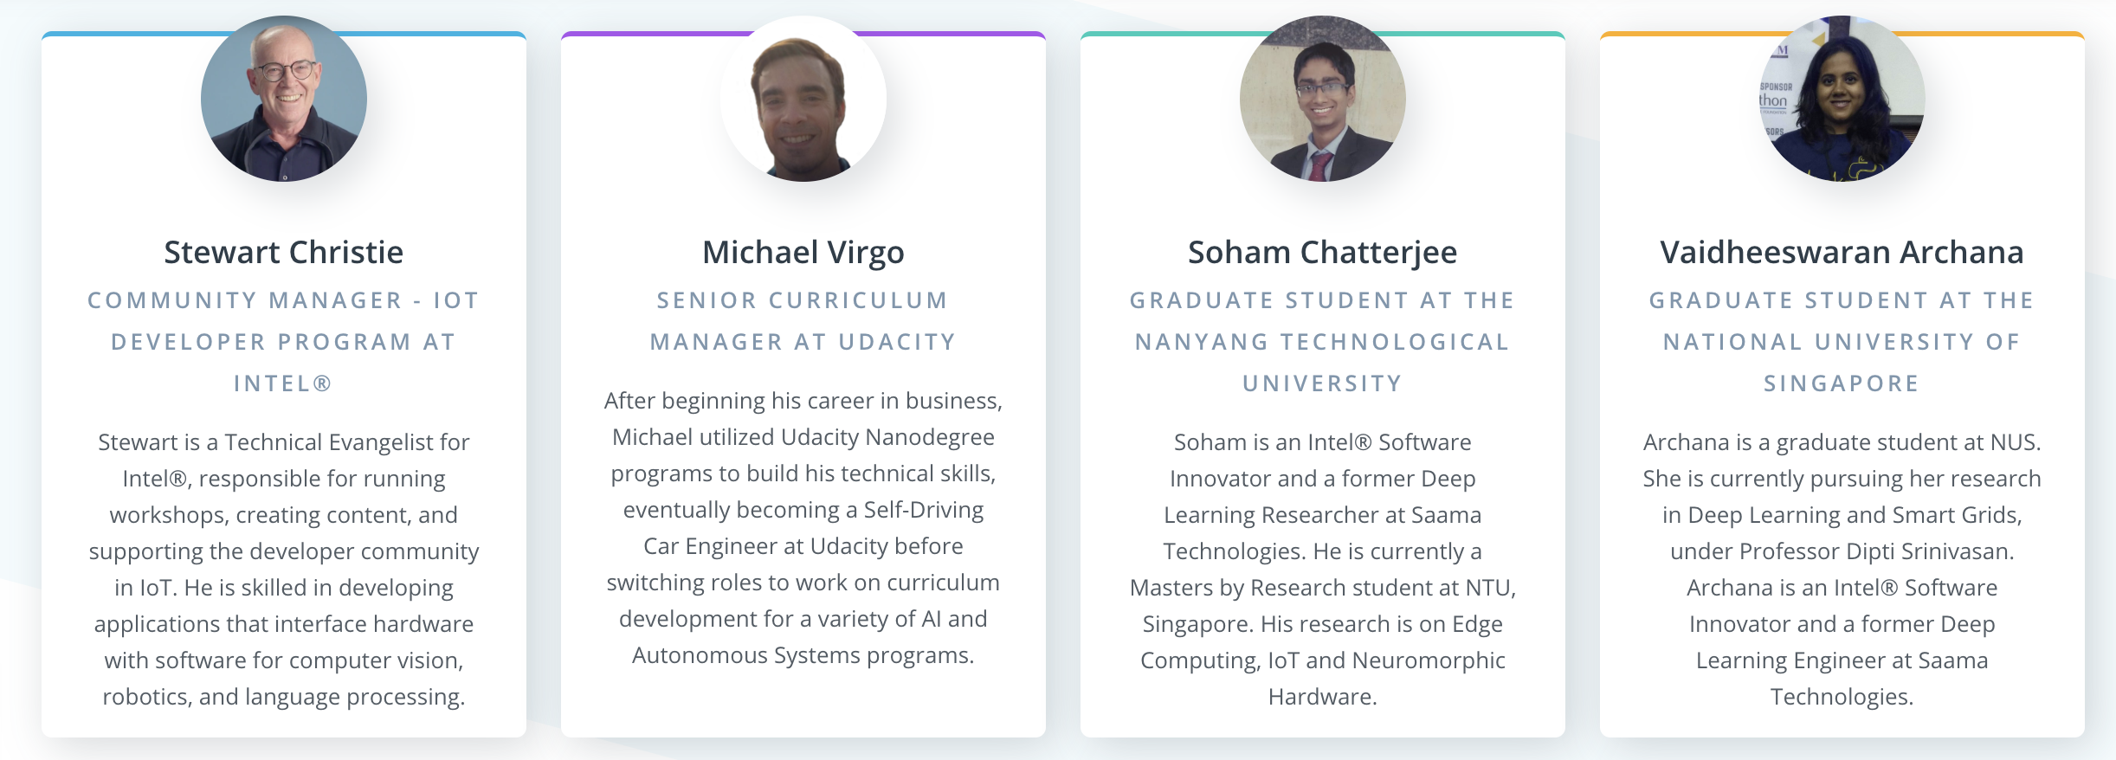
Welcome to Phase 2!
Access your Intel® Edge AI for IoT Developers Nanodegree program through your course card in your classroom:
https://classroom.udacity.com/me
Program is devised of content & curriculum to support 3 technical projects.
Look at each project as an opportunity to demonstrate your skills to potential employers.

Slide 6
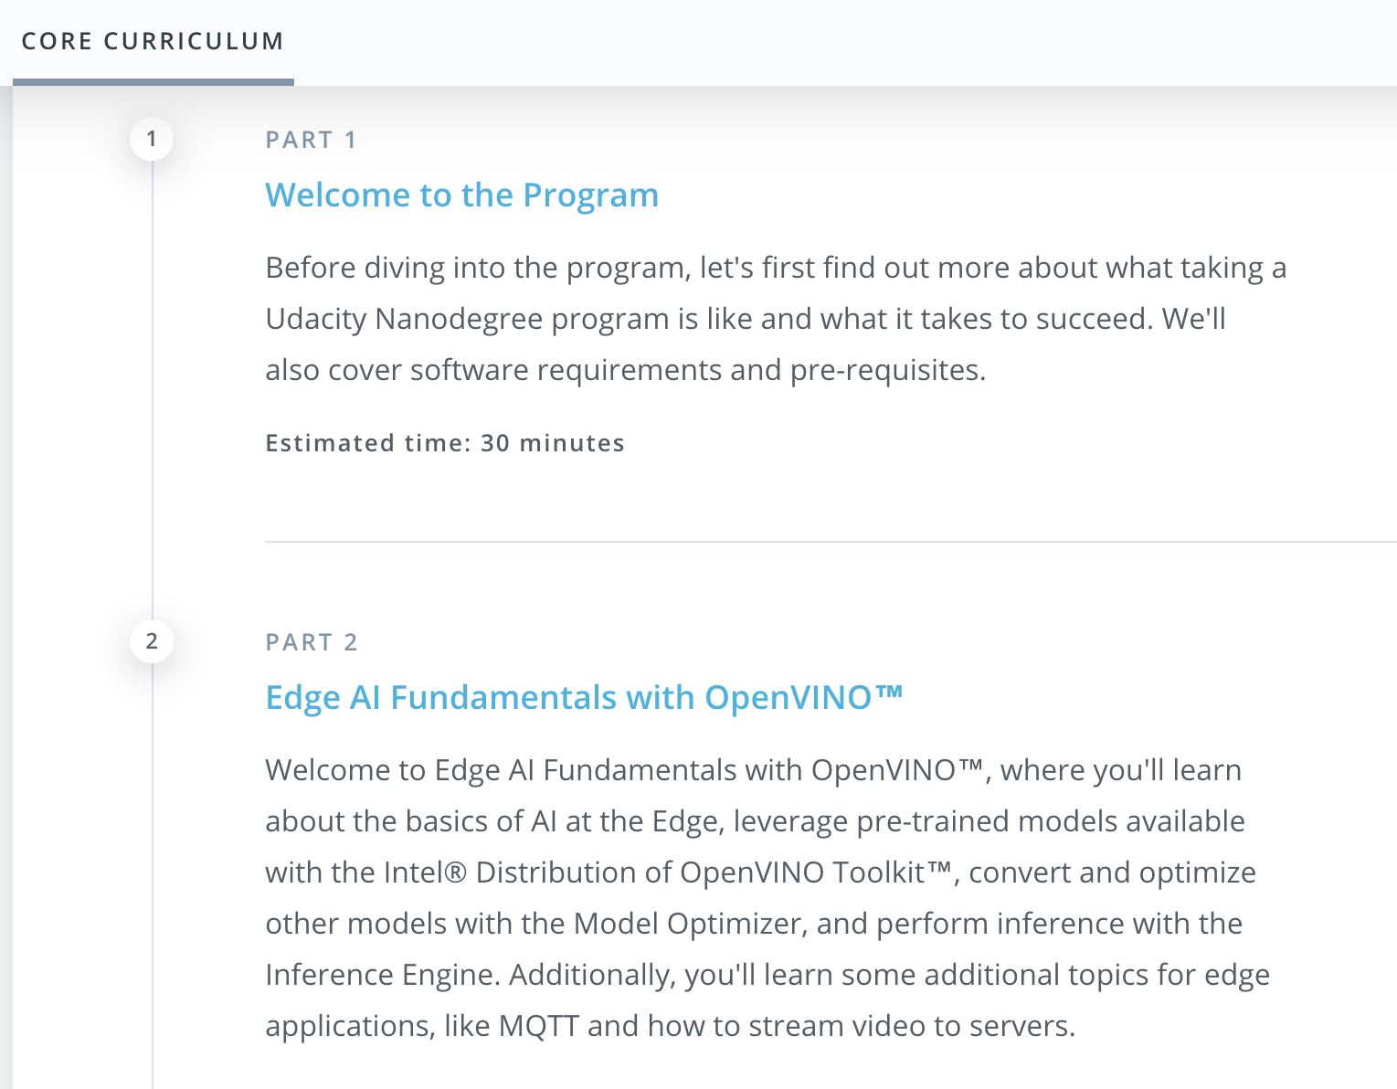
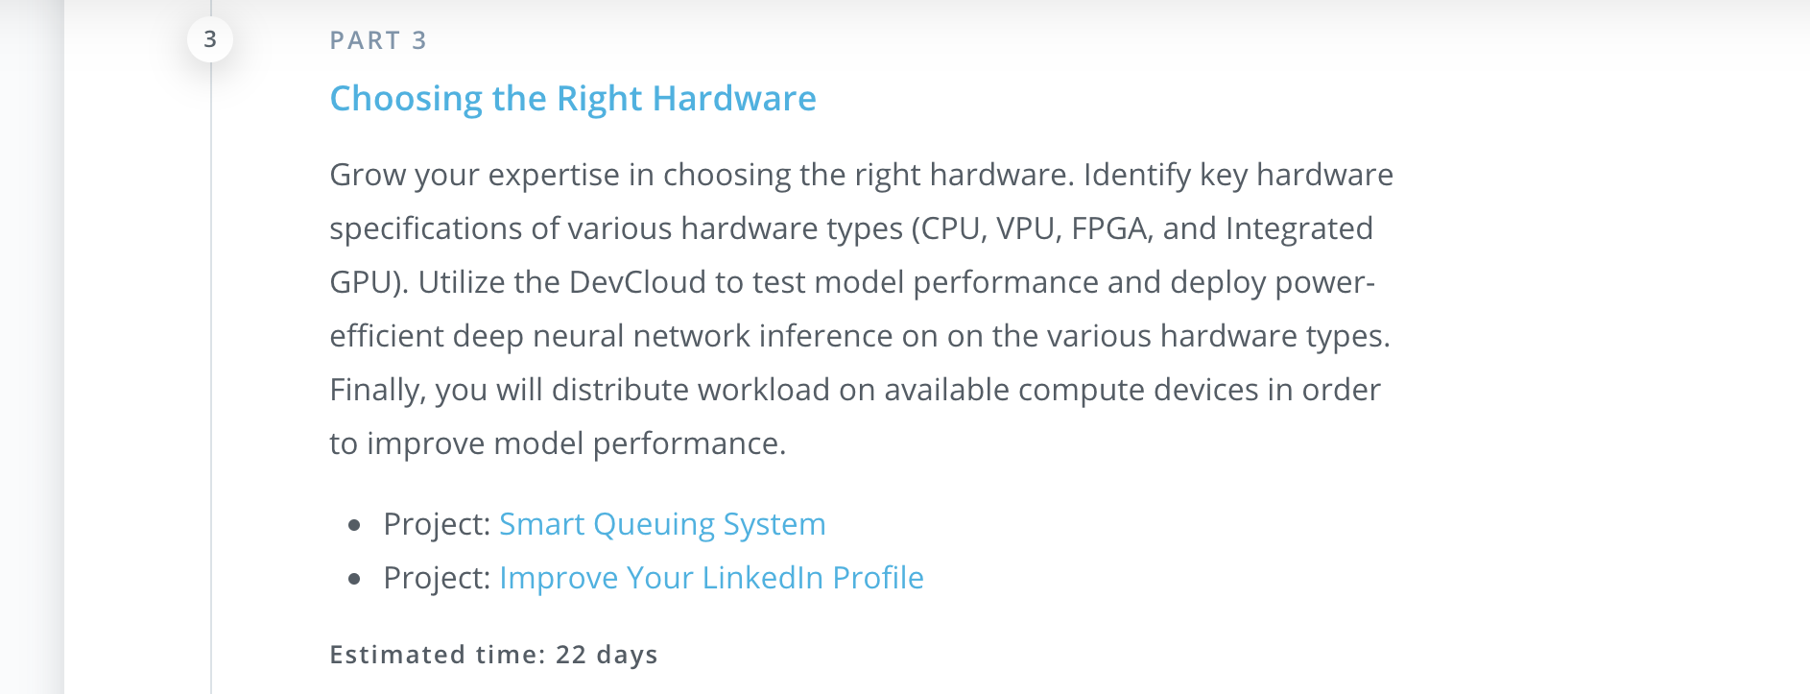
Program Syllabus
4 Parts (1 Welcome + 3 Content sections)
5 Projects (3 Technical + 2 Career)
Projects:
Deploy a People Counter App at the Edge: Detect the #of people in a frame and time spent
Smart Queuing System: Build a custom queue for Retail, Manufacturing, Transport
Computer Pointer Controller: Use models to control your computer using your eye gaze
Estimated 3 months complete this working 10 hours per week. Your program end date is July 30, 2020

Slide 7
Nanodegree Project Summary
You must complete and pass these technical projects in order to graduate!
Deploy a People Counter App at the Edge
Smart Queuing System
Computer Pointer Controller
You must pass or opt out of these Career projects in order to graduate:
Optimize your GitHub profile
Improve your LinkedIn profile
Each technical project will have a brief project overview outlining the project.
Each technical project will also have a project rubric — a list of specifications you are expected to meet.
When your project is ready, follow instructions and formally submit your technical project for code review.
Take your projects seriously and use them to solidify your own knowledge and mastery of the skills and concepts you learn throughout the Nanodegree program

Slide 8
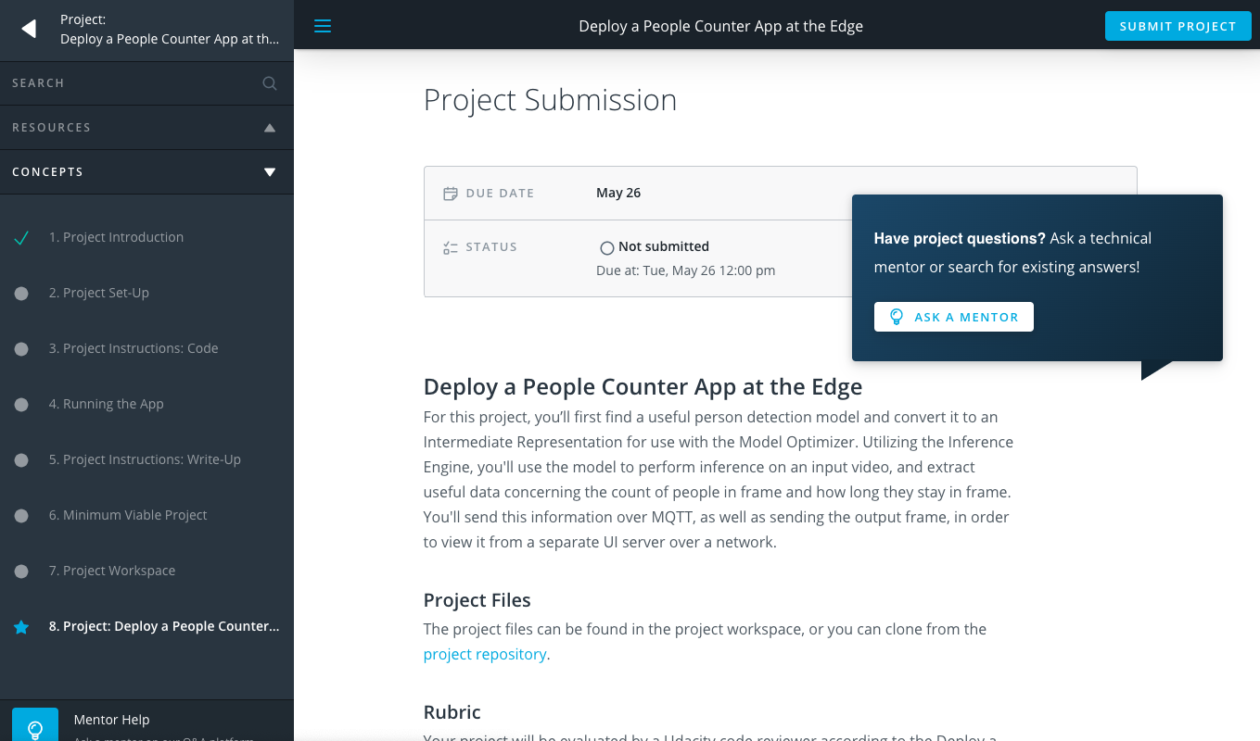
Project Overview Page

Slide 9
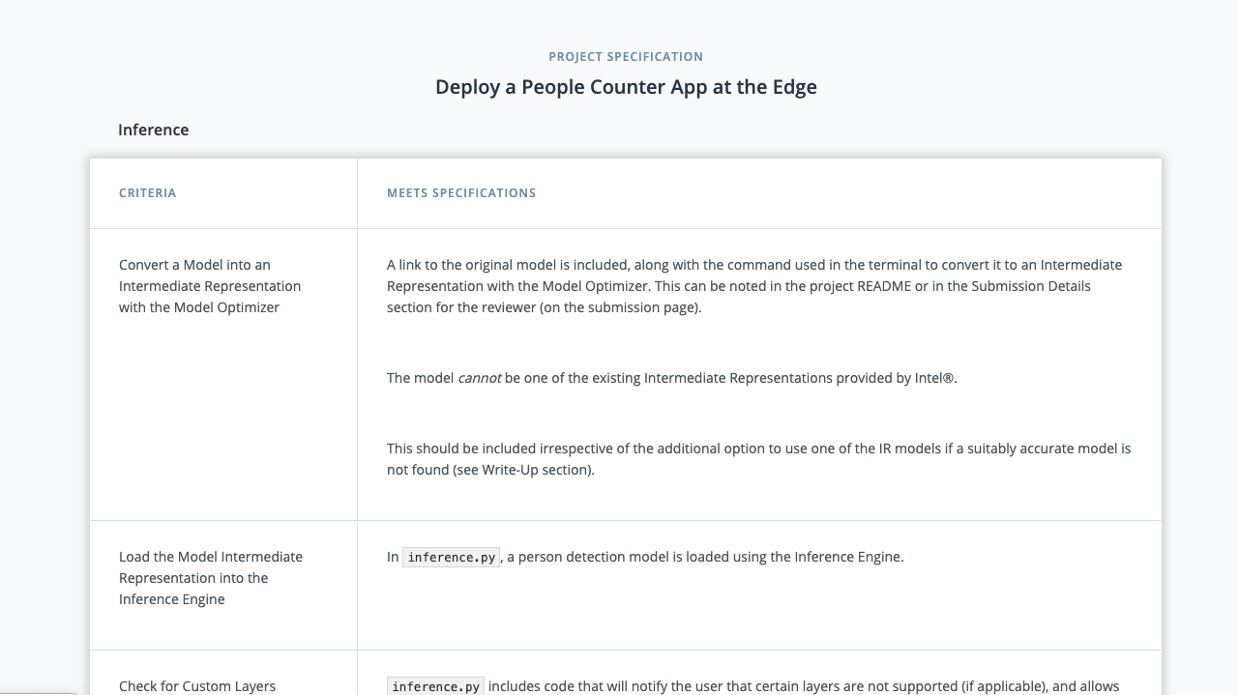
Project Rubric

Slide 10
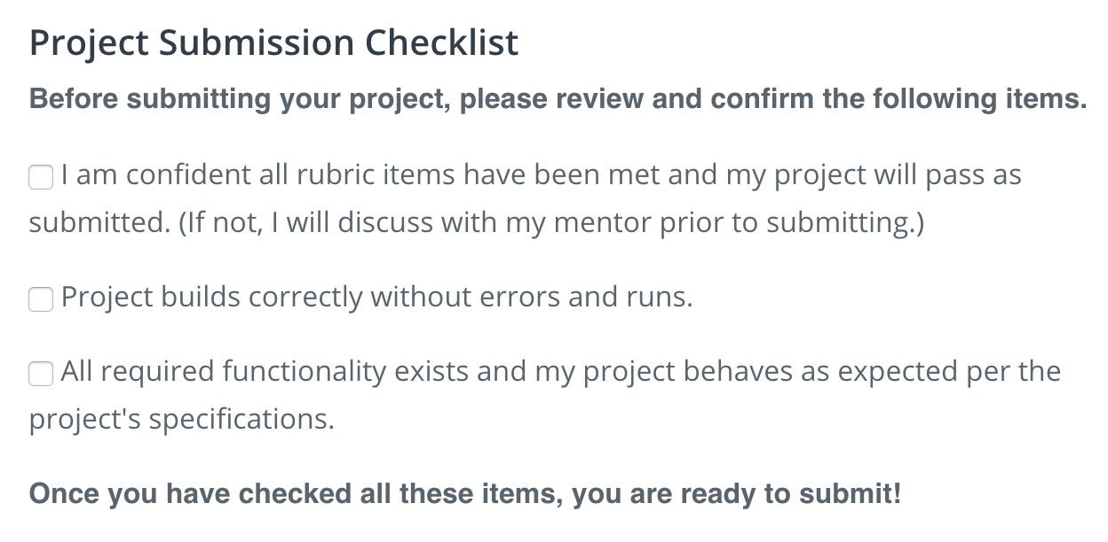
Project Submission Checklist

Slide 11
Project Review
Process

Slide 12
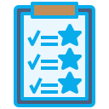
Each technical project must be formally submitted for code review.
Project reviews can take up to five days to receive a project review depending on submission volume; plan ahead and don’t leave work until the last minute!
If you do not pass a project on the first attempt, you can make changes and resubmit your project as many times as needed. There are no penalties for re-submitting a project.
If you submit your final project right before the final program deadline and it does not pass, you will not be able to re-submit the project if the final program deadline has passed. (There is only ONE deadline … and that is July 30th, 2020 for the entire program)
There is no way to “cancel” a submission if you accidentally submit your project prematurely. You will need to wait until the project comes back rejected and marked as “requires changes” to resubmit.
Project
Reviews

Slide 13
Frequently Asked Questions
Q. Will I be penalized for missing a project deadline?
A. The projects are soft deadlines - no penalties if you miss them! However, we recommend staying as close to them as possible to ensure you graduate by your final program deadline of July 30th, 2020.
Q. How do I graduate?
A. You will graduate once all technical projects have been submitted, you must complete every technical project in order to graduate - no exceptions!
Q. Do I need to complete all concepts and quizzes to graduate?
A. No. You can still graduate even if you skip concepts or quizzes. However, many of these are important in helping you solidify your understanding of the concepts you will apply in the projects, we recommend completing all of them.

Slide 14
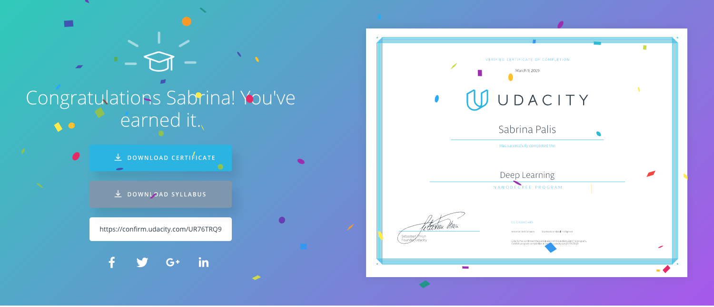
The goal: A Nanodegree Certificate! 🚀

Slide 15
Plagiarism and
Academic Honesty

Slide 16
Academic Honesty
Udacity takes academic honesty and plagiarism very seriously. For a comprehensive overview and examples of what constitutes academic dishonesty, visit the Udacity Support page.
Plagiarism in any form is a violation of the Udacity Honor Code. If after review of the suspected plagiarism, Udacity determines that the work is not your own, you will be notified and the submission will be rejected. If you break the Udacity Honor Code, you may face expulsion from your Nanodegree program or the Udacity platform, or have your graduation credential revoked if plagiarism is discovered after you graduate.
© 2017 Udacity. All rights reserved.

Slide 17
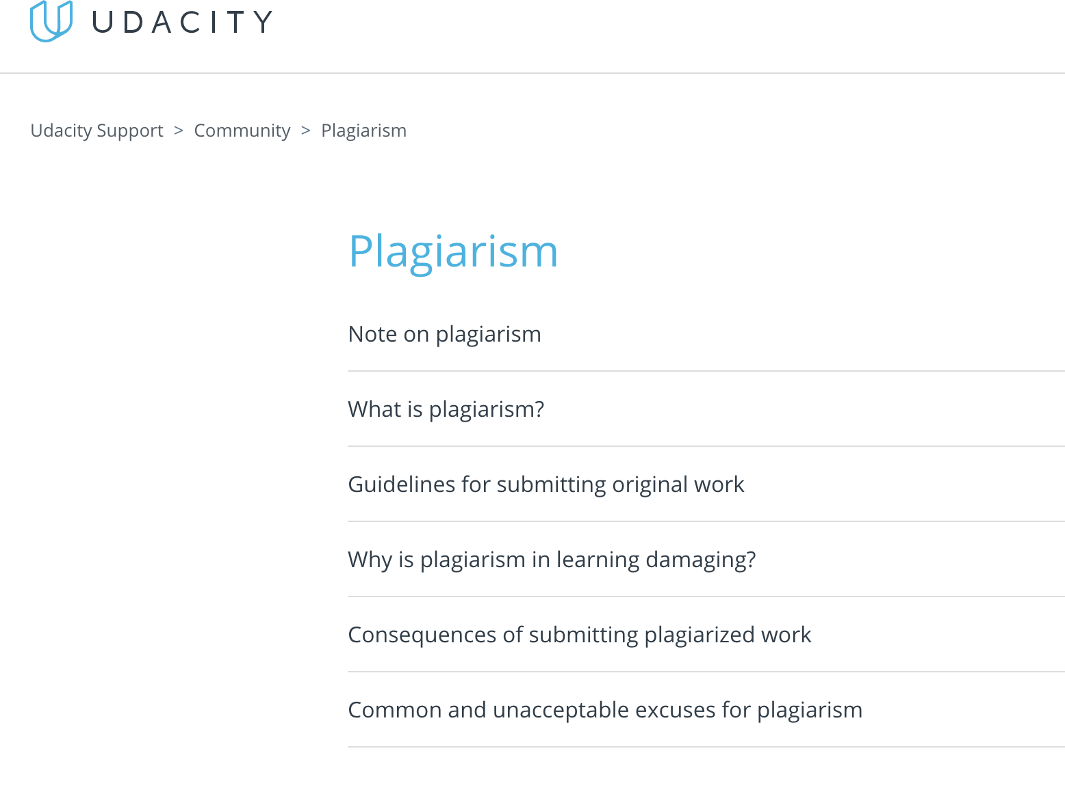
Academic Honesty (cont.)
It is YOUR responsibility to know what constitutes plagiarism.
Unsure? Please review our Plagiarism Help articles to find answers to any questions or concerns you may have!
© 2017 Udacity. All rights reserved.

Slide 18
Plagiarism
If your project is flagged for plagiarism by our reviewers, the following will occur:
1st offense: When accused of plagiarism for the first time, student will be reminded of the expectations set forth by the Udacity Student Code of Conduct
2nd offense: If accused more than once, students are sent a second warning email and immediately blocked from submitting the project again. Email states the student has 7 days to appeal the accusation. If they do not, they are removed from the Nanodegree immediately.

Slide 19
What Counts as Academic Dishonesty?
Copying another person’s code verbatim and submitting it in a project
YES
Copying code or using code that has been provided for you and approved for use in your project by Udacity
NO
Working on a project with a peer, writing code together that overlaps, and submitting it as two separate projects
YES
Using someone else’s code and providing the name of the person it belonged to as credit to their work
YES
© 2017 Udacity. All rights reserved.

Slide 20
Phase 2
Resources
Notes:
CLAYTON

Slide 21
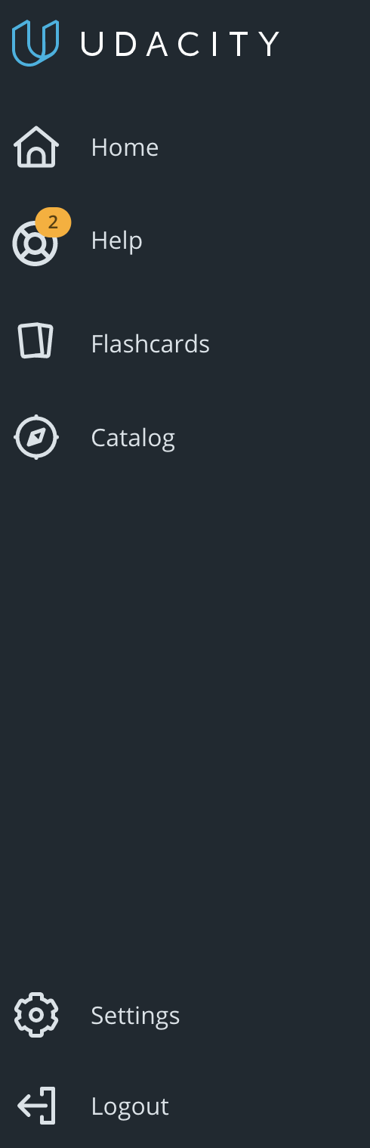
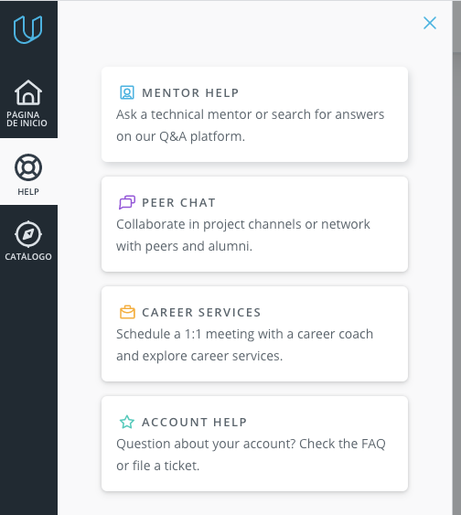
Where do I ask for help?
Once you’re in your classroom dashboard, you will see a side menu bar like the one show on the far left
The Help button: This is where you can find all your resources!
Mentor Help: access to help from mentors on Udacity’s Q&A platform, Knowledge
Peer Chat: Find and chat with peers enrolled in the same ND
Careers: Schedule 1:1’s with Udacity’s Career Coaches and explore career services
Account Help: Get in touch with our Support team for account issues
Notes:
Add Careers! 🚀

Slide 22
Knowledge (Udacity’s Q&A Platform)
THINGS TO KNOW:
Knowledge is your one-stop shop for any and all help.
Access Knowledge by clicking “Mentor Help” under the Help section in your classroom!
Reply times are fast! Usually within a couple of hours
Think of this tool like an online Live FAQ where you can get answers to technical questions.
Still have questions on how Knowledge works? Check out our 👉Knowledge Helpdesk!👈

Slide 23
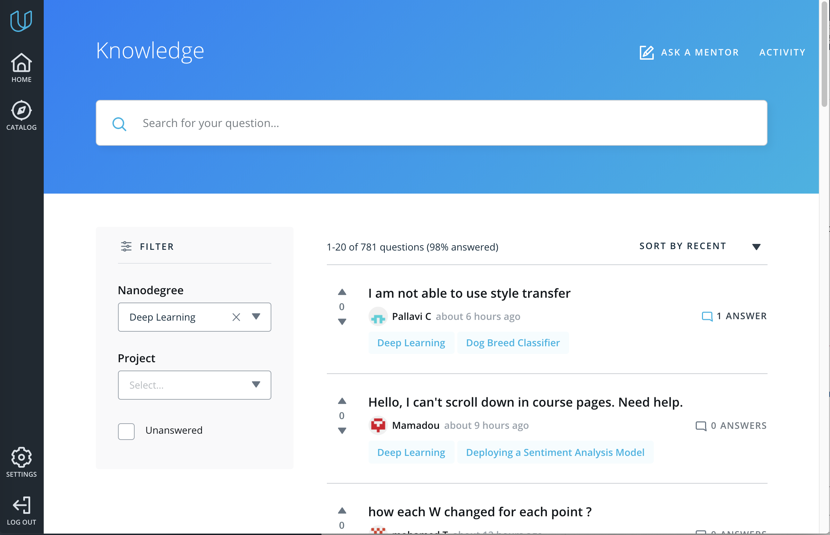
Knowledge (Cont.)
Knowledge is designed to assist you with your technical questions! Open 24/7 — Mentors are here to help you!
But how do I use it?
You can ask a Mentor any question by clicking the “Ask a Mentor” button.
View your archived Q & A’s in the “Activity” section.
Always be resourceful!
Use the filter to search and ask for questions before asking a mentor. Someone most likely has already asked!

Slide 24
Student Hub
The in-classroom chat platform that connects you with fellow students
THINGS TO KNOW:
Student Hub is your replacement for your Phase 1 Slack Community space
Access Student Hub by clicking “Peer Chat” under the Help section in your classroom!
There are a few main Community Channels
30 Days of Udacity
Careers
Community Office Hours
Project Channels

Slide 25
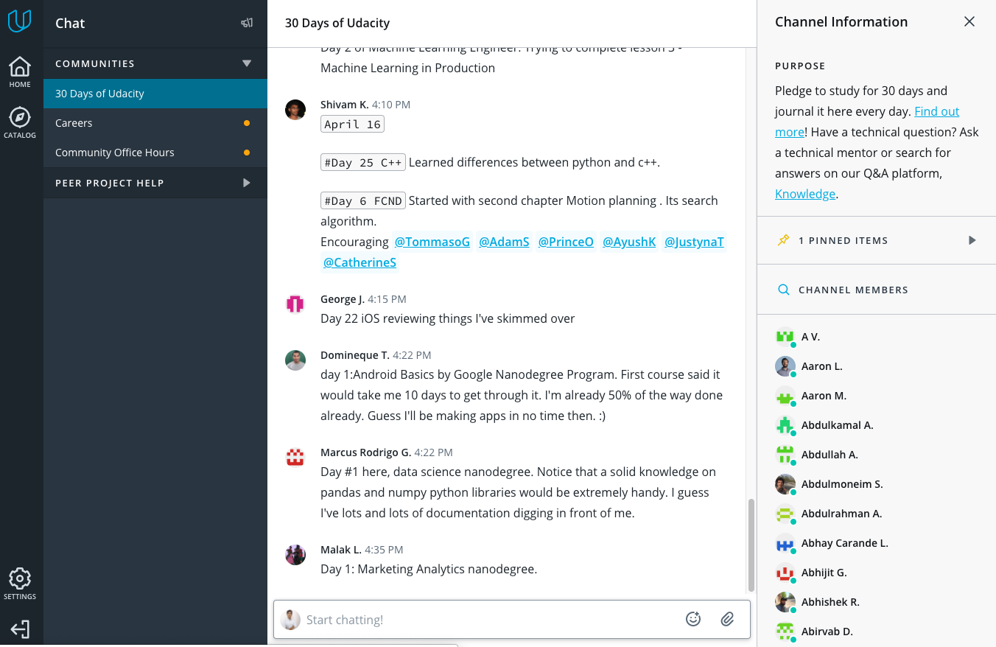
Student Hub (30 Days of Udacity)
30 Days of Udacity is very similar to what we did during Phase 1:
Pledge to study for 30 days and document your journey in this channel every day
Take the pledge at bit.ly/30Pledge
Learn more at bit.ly/30-days-of-udacity
Click here to access the 30 Days webpage!

Slide 26
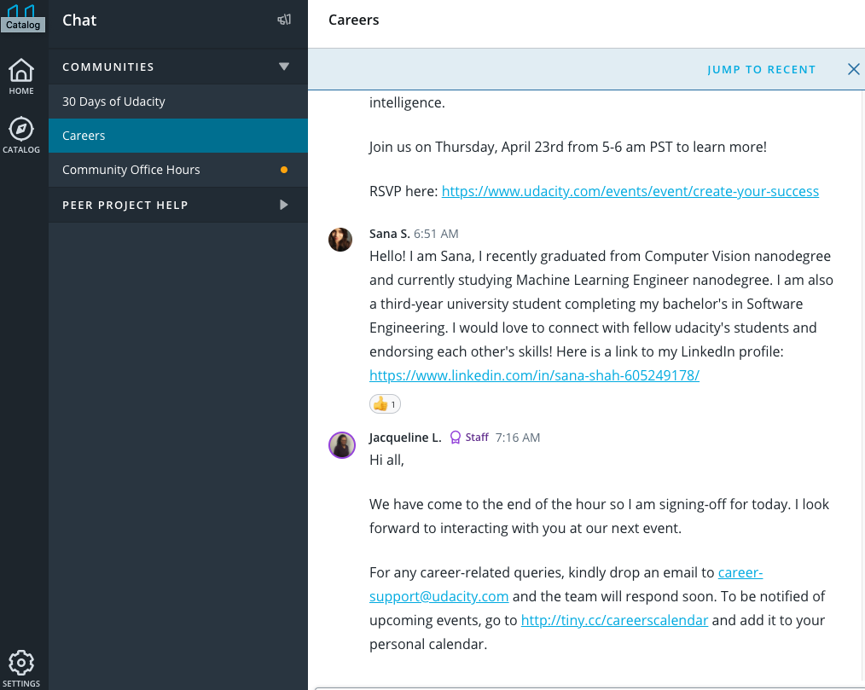
Student Hub (Careers)
For Udacity career coaching, webinars, events, and anything related to job search support.
Look for staff in Student Hub like Jacqueline L to post about career webinars and events!

Slide 27
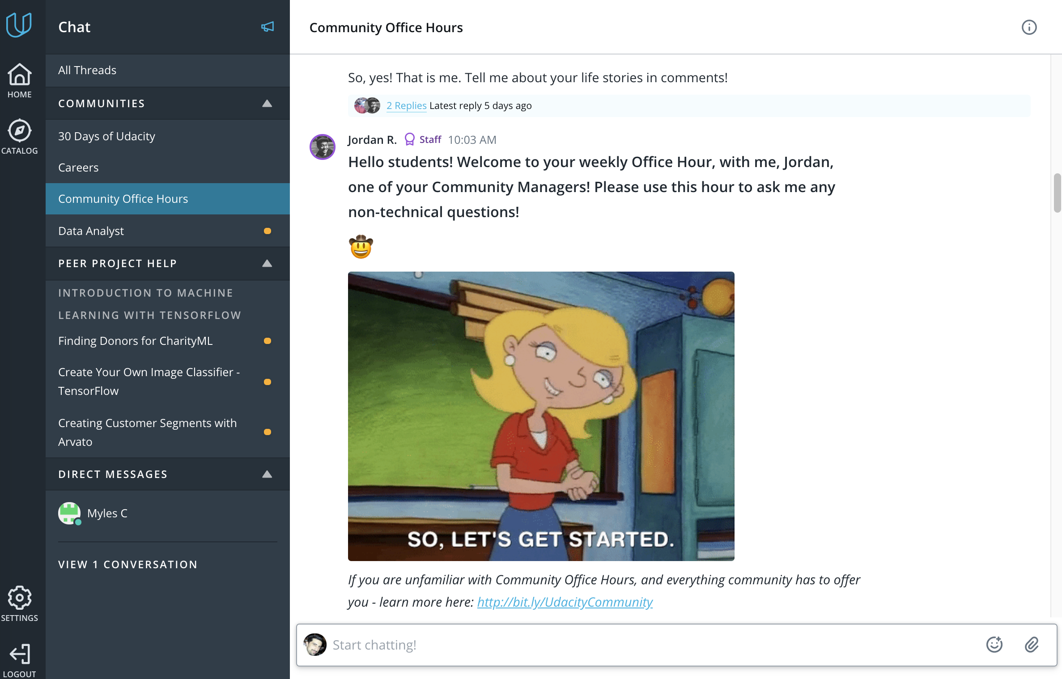
Student Hub (Community Office Hours)
Connect with classmates from every Nanodegree program and stay informed with announcements from your Community team!
Community Office Hours happen twice a week!
Every Tuesday with Prerona S.
9:30 - 10:30 PM PDT Wed., 4:30 - 5:30 AM GMT Wed. 10 AM - 11 AM IST
Every Thursday with Jordan R. 10 - 11 AM PDT 6 - 7 PM GMT 11:30 PM - 12:30 AM IST

Slide 28
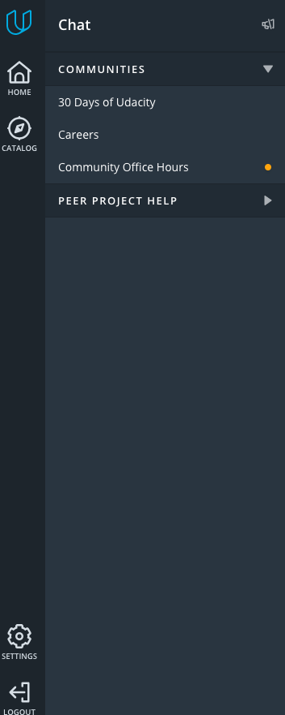
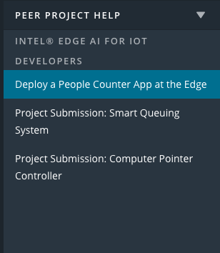
Student Hub (Project Channels)
Connect with all students in your Nanodegree program
Under Peer Project Help, you will find a channel for each project you will have to submit!
Access the channels by expanding the Peer Project Help menu on the sidebar

Slide 29
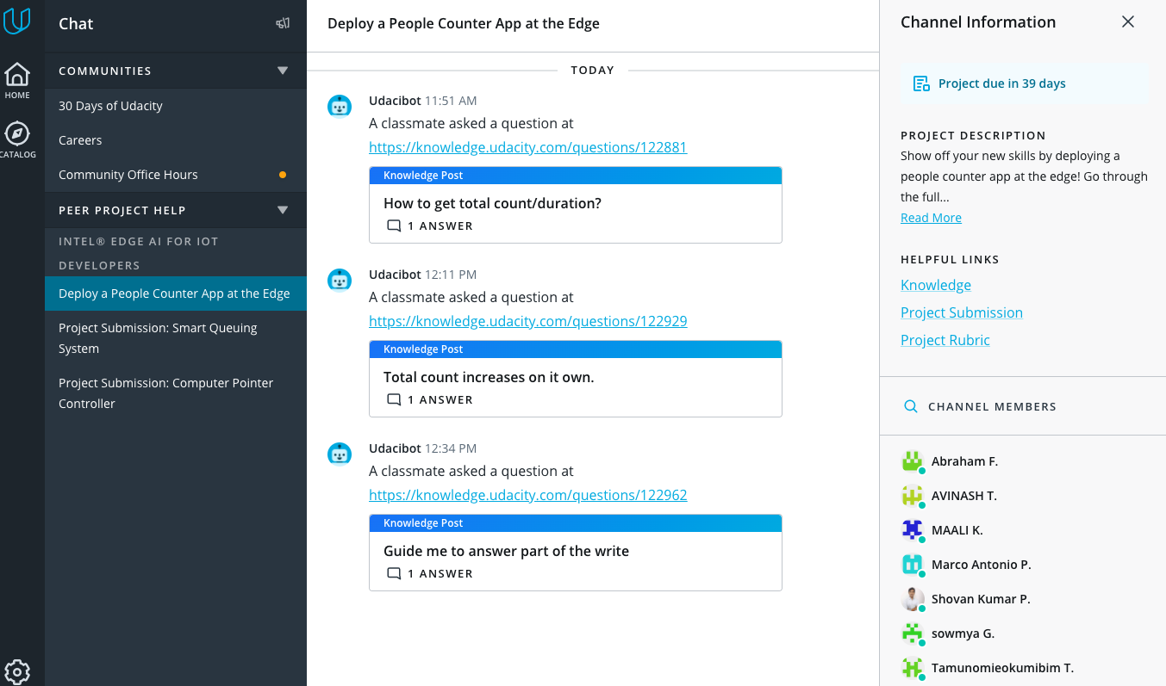
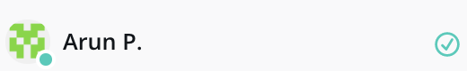
Student Hub (Project Channels)
Under the Channel Information you can access helpful links and project descriptions
In the member lists, you can find your peers
Find people who have passed that particular project with a green check mark added to their names in the right panel)

Slide 30
Advice from Past
Udacity Scholarship Graduates!

Slide 31
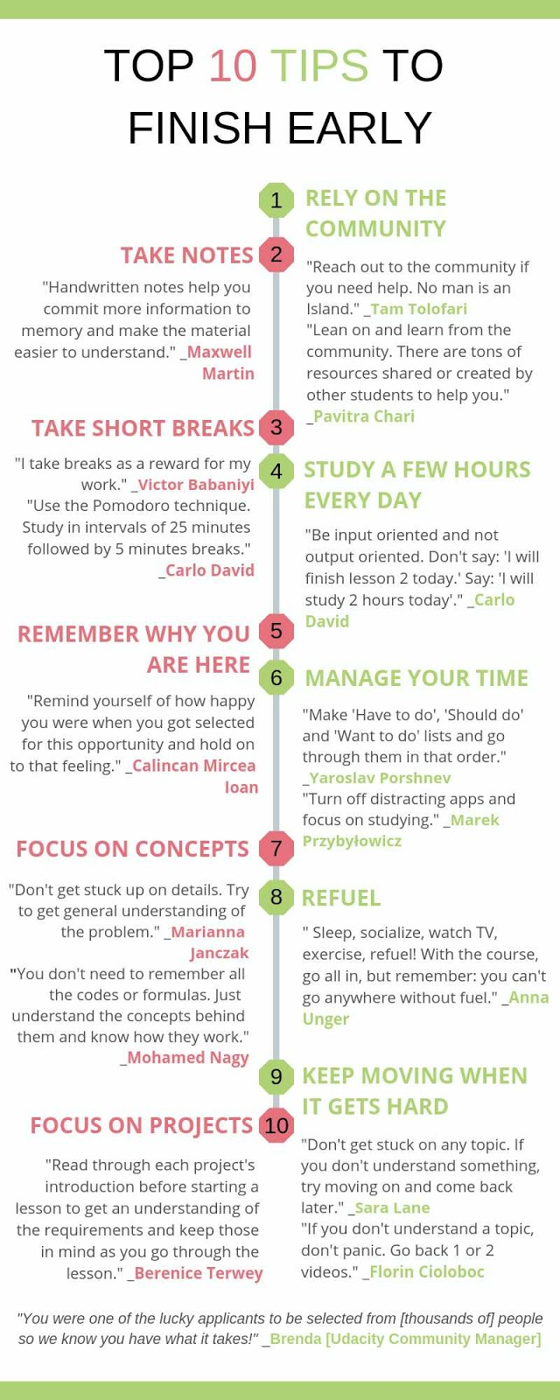
Top 10 Tips for Finishing Early
Rely on the Community
Take notes
Take short breaks
Study a few hours every day
Remember why you are here
Manage your time
Focus on concepts
Refuel
Keep moving when it gets hard
Focus on projects!
You’ve got this! 🌟
Notes:
View the larger graphic on the Google site here:

Slide 32
Let’s wrap it up…!
Q. When does Phase 2 end?
July 30, 2020 is the deadline for completing your Nanodegree program
Q. Do I need to complete all the coursework?
While lesson completion is not mandatory like it was in Phase 1, these lessons do support your project completion. You must pass all of your technical and your career projects before July 30th in order to graduate!
Q. Will I be able to access the Nanodegree program past the program deadline?
At this time, Scholarship students will be unenrolled once the deadline has passed.
Q. If I’m not able to start the Nanodegree right now, can I receive an extension?
The program deadline is firm, so do everything you can to finish by July 30th!
.
Yes, if you want to graduate. All coursework must be complete by
Best of luck everyone!!
© 2019 Udacity. All rights reserved.

Slide 33
Q&A
Type your questions in chat!

